Slide 1
Data analysis for GRTS surveys with the spsurvey package in R
Leigh Ann Starcevich & Matt Nahorniak
CHaMP GRTS workshop
August 22-23, 2012
Portland, Oregon

Slide 2
R
R is a free software environment for statistical computing and graphics. It compiles and runs on a wide variety of UNIX platforms, Windows and MacOS.
The software and documentation are available at:
  http://www.r-project.org/.

Slide 3
Using the spsurvey package
Download within R by going to Packages > Install package(s) and selecting spsurvey
The user manual (Kincaid, 2012) and vignettes providing examples are also available at the CRAN website:
  http://cran.r-project.org/
  Go to Packages
  Choose spsurvey
Make available for use by typing library(spsurvey) at the R prompt
  This needs to be done for every R session

Slide 4
Outline
Functions
  grts: draw a GRTS sample
  adjwgt: adjust design weights for unbiased analysis
  cat.analysis: design-based analysis of categorical indicators
  cont.analysis: design-based analysis of continuous indicators
Examples

Slide 5
grts function
Use to draw a GRTS sample
Can incorporate design complexity such as:
  Stratification
  Variable probability sampling
  Panel structure
Obtain a spatially-balanced sample across the resource
  Finite
  Linear
  Area

Slide 6
grts options
design: specify the sampling design
DesignID: name of design, used to create site ID’s
type.frame: finite, linear, or area
in.shape: input shapefile
att.frame: attribute data frame
stratum: stratification variable
mdcaty: name of unequal probability category
out.shape: name of output shapefile

Slide 7
grts design options
design is an R list of design specifications
  Each component of the list corresponds to a stratum name
  List names must match stratum names!
Each stratum list has four components:
  panel: Vector of sample sizes for each panel
  seltype: Equal, Unequal, or Continuous
  caty.n: Sample size by category for Unequal probability sampling
  over: Number of oversample sites

Slide 8
Examples
GRTS code to draw samples
  SRS with no panels
  SRS with four panels
  StRS with four panels

Slide 9
Lemhi SRS – no panels
att<- read.dbf(LemhiFrameFinal_20120527.dbf)
DesignSpecs.SRS.nopanel <- list(None=list(panel= c(PanelOne=45), seltype="Equal"))
Lemhi_GRTS_SRSNOPANEL1 <- grts(design= DesignSpecs.SRS.nopanel,
DesignID='Lemhi',
type.frame='linear',
in.shape='LemhiFrameFinal_20120527',
att.frame=att,
prjfilename= 'LemhiFrameFinal_20120527',
out.shape='Lemhi_GRTS_SRSNOPANEL_sample)

Slide 10
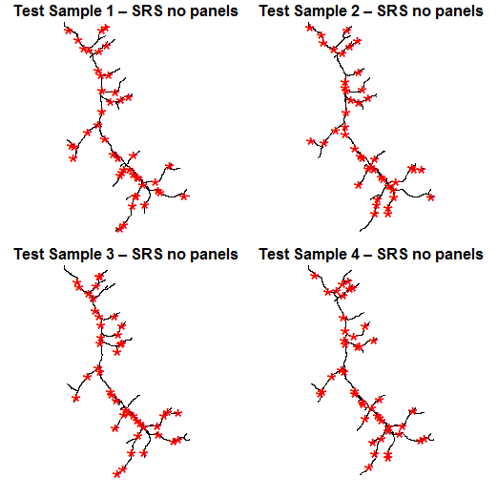
Lemhi SRS
No panels

Slide 11
Lemhi SRS - panels
DesignSpecs.SRS <- list(None=list(panel=c(Panel1=15, Panel2=30, Panel3=30, Panel4=30), seltype=Equal))
Lemhi_GRTS_SRS1 <- grts(design= DesignSpecs.SRS,
DesignID='Lemhi',
type.frame='linear',
in.shape='LemhiFrameFinal_20120527',
att.frame=att,
prjfilename='LemhiFrameFinal_20120527',
out.shape='Lemhi_GRTS_StRS_sample1')

Slide 12
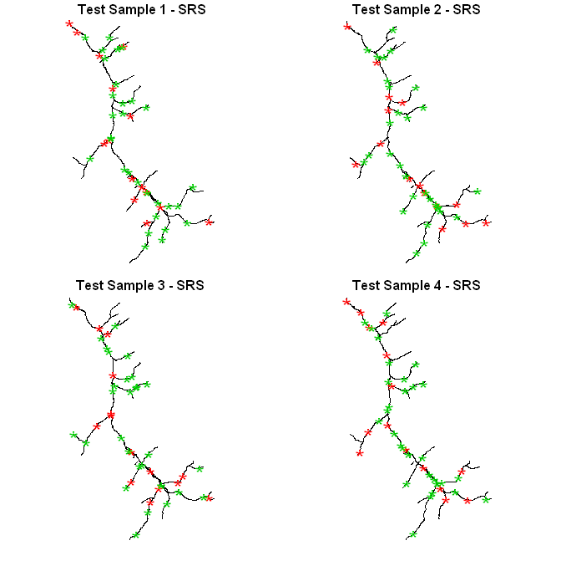
Lemhi SRS
Annual Sites
Rot Panel 1

Slide 13
Lemhi StRS GRTS code
DesignSpecs.StRS <- list(
Depositional = list(panel=c(Panel_1= 5, Panel_2=10, Panel_3=10, Panel_4=10), seltype=Equal, over=10),
Source = list(panel=c(Panel_1= 5, Panel_2=10, Panel_3=10, Panel_4=10) , seltype=Equal, over=10),
Transport = list(panel=c(Panel_1= 5, Panel_2=10, Panel_3=10, Panel_4=10) , seltype=Equal, over=10))
Lemhi_GRTS_StRS1 <- grts(design= DesignSpecs.StRS,
DesignID='Lemhi',
type.frame='linear',
src.frame='shapefile',
in.shape='LemhiFrameFinal_20120527',
stratum= "v_class",
att.frame=att,
prjfilename= 'LemhiFrameFinal_20120527',
out.shape='Lemhi_GRTS_StRS_sample1')

Slide 14
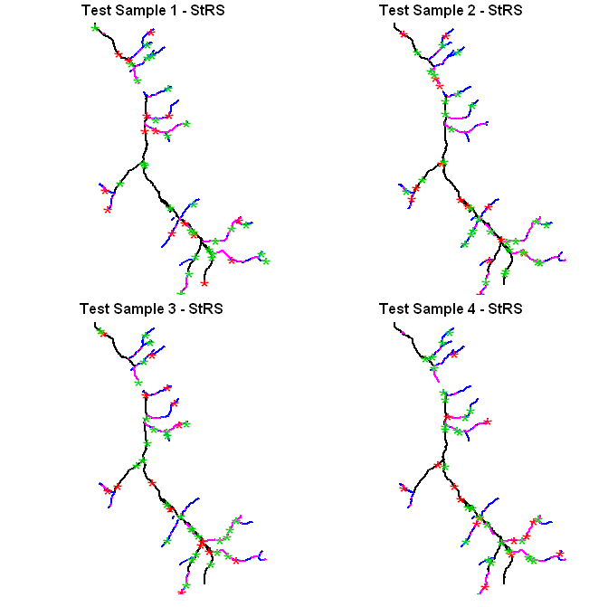
Lemhi StRS
Depositional
Source
Transport
Annual Sites
Rot Panel 1

Slide 15
GRTS samples
Order of the GRTS design file is important for maintaining spatial balance
Visit the main sample before using oversample sites
Site disposition is critical for proper analysis
Large oversamples can weight samples away from the design and toward relative population sizes

Slide 16
Adjust weights
Use adjwgt function to adjust weights based on adjusted frame sizes
Need:
  Site IDs
  Original design weights
  Categories within which weight is adjusted
  True frame size by category

Slide 17
Simple example
Stratum | Original frame (km) | Sample size | Original weight | Revised frame (km) | Revised weight
1 | 6 | 3 | 2 | 5 | 1.67
2 | 9 | 3 | 3 | 7 | 2.33
wgt.test<-c(rep(2,3), rep(3,3))
frame.test<-c(5, 7)
names(frame.test)<-c(1,2)
wtcat.test<- c(rep(1,3), rep(2,3))
sites.test<-1:6
new.wgts<-adjwgt(sites.test, wgt.test, wtcat.test, frame.test)
cbind(wgt.test, new.wgts)

